Slide 1
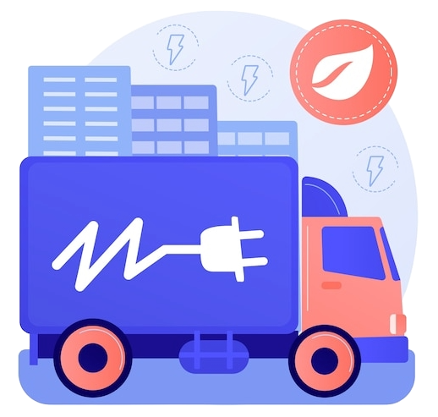
FY26 MEDIUM-DUTY AND HEAVY-DUTY ZERO-EMISSION VEHICLE (MHD ZEV)
GRANT PROGRAM
Natalie Buscemi
Transportation Program Manager
Maryland Clean Cities and Communities Coalition Director

Slide 2

AGENDA
FY26 Medium-Duty and Heavy-Duty Zero-Emission Vehicle Grant Program
Program Requirements & Ineligible Projects
Evaluation Criteria Overview
Key Grant Features

Slide 3

FY26 MHD ZEV GRANT PROGRAM OVERVIEW
Program Description:
The Program provides financial assistance for the purchase of qualified, newly manufactured
medium-duty or heavy-duty zero-emission fleet vehicles, as well as qualified zero-emission heavy
equipment property, for commercial or industrial use.
Key Details:
Application Deadline: October 30th, 2025 3:00pm ET
Eligible Applicants: Local governments, non-profit organizations, business and company fleets, airports, higher education institutions and K-12 schools
Eligible Vehicles: Class 3-8 vehicles with GVWR ≥ 10,000 lbs
Statewide competitive application process.
Notes:
Link to webpage to show where things are during webinar: https://energy.maryland.gov/transportation/Pages/MediumandHeavyDutyGrant.aspx
Utilizing new portal! https://mdmea.my.site.com/MEAPrograms/
Statewide competitive process – once deadline is reached, we start evaluating applications received and will determine which projects will get funded.

Slide 4

PROGRAM REQUIREMENTS & INELIGIBLE PROJECTS
Requirements:
Applicants: Local governments & entities with ≥ 3 vehicles in fleet
Vehicles must be domiciled/operated in Maryland for at least 3 years
Purchase orders must be dated after grant agreement effective date
Applicant must be in good standing with the Maryland State Department of Assessments and Taxation
Ineligible Projects/Entities:
State/federal agencies
Personal use vehicles, NEVs, LSVs, parallel and series plug-in hybrids, or repowered vehicles
Vehicles purchased for resale
Vehicles already funded (or expecting funding) under VW Trust Fund or other state programs
Please Note: This grant does not provide funding for charging infrastructure. MEA has other programs that might suit your funding needs for charging infrastructure—please visit the website to find additional details about these opportunities.
Notes:
NEVs: neighborhood electric vehicles
LSVs: low-speed vehicles
Purchase orders being dated after grant agreement: vehicles can’t be purchased before, during, or after the application process and Commitment Letter. MEA will communicate with grantees when it’s time to order vehicles.
Vehicles purchased for resale: minimum of 3 years is required for reporting, therefore, vehicles must be domiciled/operated in the state during this time or risk having to return funds.
Vehicles already funded (or expecting funding) under VW Trust Fund or other state programs: Vehicles can’t receive funding if already awarded funds through other State programs (i.e., needs to be new vehicles for this round of funding).

Slide 5

EVALUATION CRITERIA OVERVIEW
Preference for projects that replace petroleum-powered vehicles
Cost-effectiveness measured in $/MTCO₂e
The GHG abatement is calculated using the type of vehicle and the vehicle miles travelled (VMT), using the AFLEET tool
The $/MTCO₂e value uses the eligible grant amount and the GHG abatement
Fleet commitment (charging/fueling plans, maintenance strategy)
Preference for projects benefiting overburdened and low-to-moderate income communities
AOI 1: Extra road safety features (AEB, ADAS, lane assist, underride guards, etc.) favored
Past MEA grant performance may be considered
Notes:
$/MTCO2e: dollar per metric ton of co2 equivalent
AEB: automatic emergency braking
ADAS: advanced driver assistance systems

Slide 6


KEY GRANT FEATURES
Grant covers up to 75% of incremental cost (ZEV vs. diesel/gas vehicle)
Grants are paid in arrears
Project completion deadline: 24 months from grant agreement execution date
Partial awards possible depending on demand & budget availability
Funding Caps:
AOI 1 (On-road): Up to $2.5M per applicant
AOI 2 (Off-road): Up to $375k per applicant
Reporting:
Progress updates prior to delivery
Quarterly reports for 3 years post-delivery (e.g., VMT, energy use, VINs)

Slide 7
Vehicle Types
Vehicle Type | Class | Weight (lbs) | Example
Single-Unit Short-Haul Truck | 3-6 | 10,001 - 26,000 | Box trucks (e.g., Ford F-650)
Single-Unit Long-Haul Truck | 7-8 | 26,001+ | Delivery trucks (e.g., Freightliner M2 106)
Refuse Truck | 7-8 | 26,001+ | Mack LR Electric, Peterbilt 520
Combination Short-Haul Truck (≤250 miles) | 7-8 | 33,001+ | Day cabs (e.g., Freightliner Cascadia)
Transit Bus | 7-8 | 33,001+ | New Flyer Xcelsior
Hydrogen (FCEV) Combination Long-Haul Truck | 8 | 33,001+ | Nikola Tre FCEV
Combination Long-Haul Truck (≥250 miles) | 8 | 33,001+ | Sleeper cabs (e.g., Volvo VNL 860)

Slide 8



Award Formula
The MHD ZEV Grant Program covers 75% of the incremental cost for the purchase of zero emission on-road vehicles and off-road equipment.
Purchase Price of Zero Emission Vehicle
Purchase Price of Petroleum Equivalent Vehicle
Incremental Cost
Eligible Grant Amount = 0.75 × Incremental Cost
Notes:
Passing to Pratiksha!

Slide 9
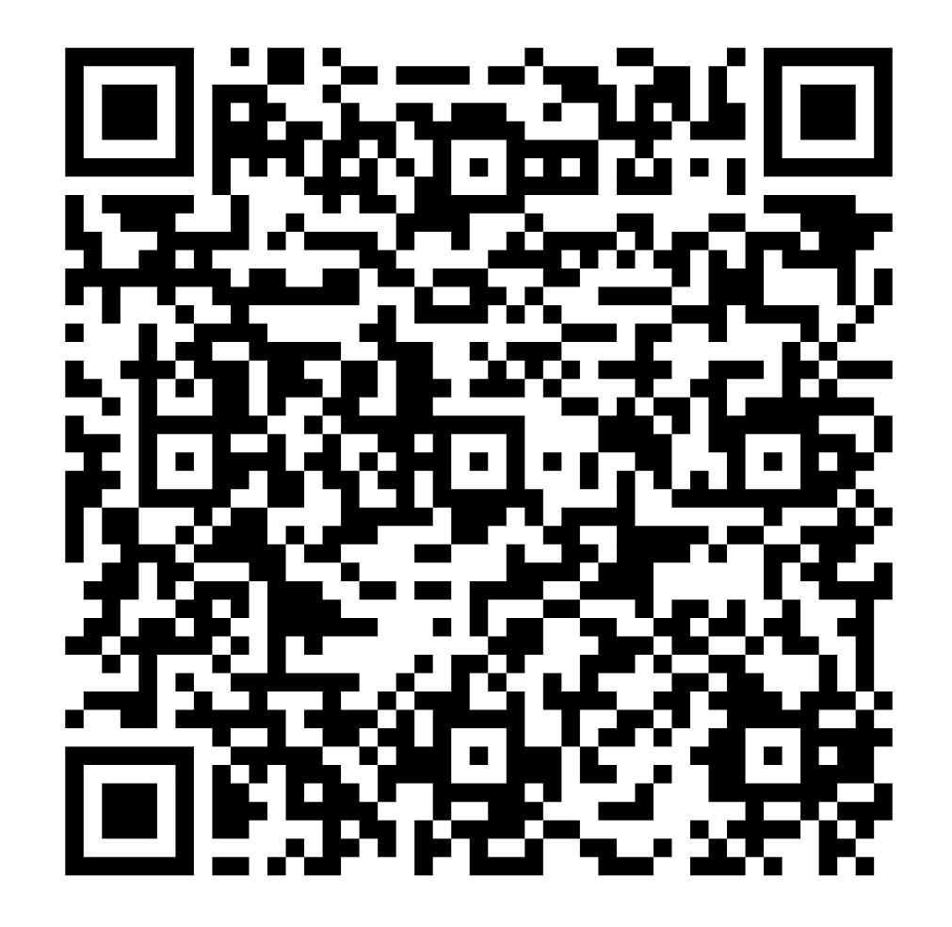
Learn More About MEA Programs
MEA offers expertise and advice to match your needs to electrify
with available programs and financial support.

Slide 10
FY26 MEDIUM-DUTY AND HEAVY-DUTY ZERO-EMISSION VEHICLE (MHD ZEV) GRANT PROGRAM OVERVIEW
Grant covers up to 75% of the incremental cost between an eligible ZEV and a comparable conventional vehicle
Grants are paid in arrears
Project completion deadline: 24 months from grant agreement execution date
Eligibility: Fleet companies, organizations, local governments, construction companies, and more
Eligible Vehicles: Class 3-8 vehicles with GVWR ≥ 10,000 lbs
Statewide competitive application process.
Application: Apply through MEA's new MyMEA online application portal.
Application Deadline: October 30, 2025, at 3:00 PM ET
Areas of Interest & Funding Caps:
AOI 1 (On-road): $8M for AOI 1, capped at to $2.5M per applicant
AOI 2 (Off-road): $2M for AOI 2, capped at to $375k per applicant
Reporting:
Progress updates prior to delivery
Quarterly reports for 3 years post-delivery (e.g., VMT, energy use, VINs)
KEY FEATURES

