Slide 1
Due Consideration of Grid-Enhancing Technologies and Advanced Transmission Technologies in CPCN Applications
Guidelines and Template for Certificate of Public Convenience and Necessity (CPCN) Applications
August 2026
Maryland Department of Natural Resources
Power Plant Research Program (PPRP)

Slide 2
Applicant Instructions: Two Supporting Materials
To support consistent, thorough evaluation of alternatives in CPCN proceedings, PPRP has prepared two documents:
Guidelines for Due Consideration of GETs and ATTs: Outlines PPRP’s expectations for a complete, defensible alternatives analysis; defines “Due Consideration,” provides a framework of questions to address and details to provide.
Sample ATT/GET Comparison Template: an Excel template that facilitates the recommended comparison; applicants are encouraged to use or adapt.
These materials are intended to promote transparency, reduce unnecessary regulatory burden, and ensure cost-effective and technically viable GET/ATT solutions receive meaningful consideration.

Slide 3
Document 1 — Guidelines
The Guidelines outline key expectations for evidence of “Due Consideration” of ATTs and GETs:
Technology-specific analysis of applicability - not a generic conclusion
Quantitative comparison of feasible alternatives to the proposed project
Evaluation of hybrid / combined solutions where appropriate
Clear documentation of assumptions, modeling inputs, and implementation constraints (technical, operational, and institutional)

Slide 4
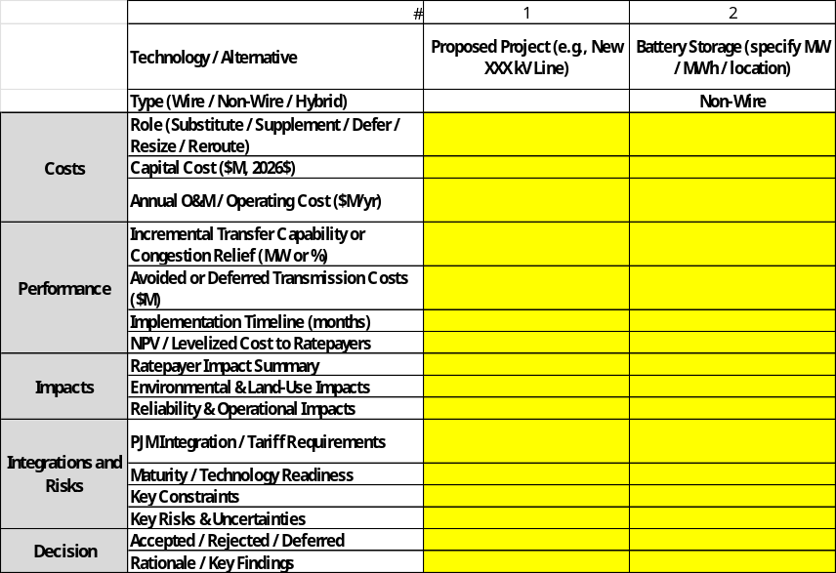
Document 2 — Sample ATT/GET Comparison
An accompanying Excel template facilitates the recommended comparison. Applicants are strongly encouraged to use or adapt it (or an equivalent format). It includes:
Rows for Type (Wire / Non-Wire / Hybrid) and Key Constraints
Pre-populated rows for common technologies (HVDC, DLR, Advanced Conductors, FACTS/STATCOMs, AAR, Topology Optimization, etc.)
Space for cost, performance, impact, and decision information

Slide 5
Submission Guidance
File as an appendix. Submit the completed alternatives analysis, including the comparison table, as a clearly labeled appendix to transmission CPCN application.
Document your inputs. Ensure all major assumptions, data sources, and PJM inputs are clearly documented.
Alternative formats allowed. Applicants may propose alternative formats, provided they fully address the checklist.

Slide 6
What “Due Consideration” Means
For purposes of PPRP review, evidence of “Due Consideration” (Section 7-207) includes a documented, technology-specific alternatives analysis that is filed as an appendix to the CPCN application and is sufficient for PPRP to evaluate application completeness.
A complete analysis should:
Identify project needs / constraints that the ATT/GETs are tested against
Screen all relevant GET and ATT categories - both Wire and Non-Wire
Compare feasible alternatives against the proposed project
Explain why each technology was accepted or rejected
Provide evidence and quantitative assessment for all recommendations

Slide 7
Guidelines: Suggested Questions
The initial application should be complete enough to answer:
What ATTs/GETs were considered?
What specific need(s) or constraint(s) were they tested against?
What evidence (modeling, studies, PJM inputs) assessed substitutability?
How do alternatives compare quantitatively - capital and operating cost, transfer capability / congestion relief, avoided or deferred costs, implementation timeline, and risk?
  What are the ratepayer, environmental, reliability, schedule, and land-use impacts of the alternatives?
  Present quantitative comparisons in a clear summary table: capital cost, NPV / levelized cost, incremental transfer capability in MW, implementation timeline in months, ROW / acres impacted, etc.
Why was each technology accepted, rejected, or deferred?
Were distribution-system / non-wires alternatives evaluated (demand response, energy efficiency, targeted distribution upgrades, hosting capacity improvements)?

Slide 8


ATT Wire vs. ATT Non-Wire
ATT Wire
Technologies directly tied to transmission lines, conductors, converter stations, control equipment, or line-rating systems.
ATT Non-Wire
Solutions that use data, controls, operating practices, or customer-side resources to improve grid performance without immediately building new transmission or distribution lines.

Slide 9
Non-Wire Technology: Storage
Due consideration
Whether storage could provide the needed transmission service - congestion relief, voltage support, power-flow control, or stability
Whether it would be planned, operated, and cost-recovered as a transmission asset - not dispatched for wholesale energy arbitrage
Applicant should identify
Size, location, duration, operating protocol, charging constraints, and deliverability
PJM tariff treatment, interconnection requirements, and cost-recovery pathway
Whether storage would replace, defer, or supplement the proposed line

Slide 10
Non-Wire Technology: Other ATTs/GETs
Ambient-Adjusted Ratings (AAR): Includes approaches that use forecasted temperatures to optimize existing transmission paths
  Due consideration should address whether AAR could increase facility capacity and reduce, resize, or defer the proposed project
Topology Optimization / Transmission Switching: Software reconfiguration of the existing grid to relieve congestion
  Due consideration should address whether alternative configurations or switching could address the project driver without adversely affecting reliability or shifting constraints elsewhere
Advanced Power Flow Control: Devices that redirect flows to better utilize existing paths
  Due consideration should address whether power-flow-control devices could relieve the constraint, improve use of nearby facilities, or reduce, resize, or defer the proposed project

Slide 11
Wire Technology: Dynamic Line Ratings
Due consideration
Whether the binding constraint is rating-related
Whether more accurate real-time or forecasted ratings could increase usable capacity
Applicant should describe
Existing rating methodology (static vs. seasonal assumptions)
Communications and sensor requirements, and PJM integration requirements
Operating procedures and expected incremental capacity

Slide 12
Wire Technology: High-Performance Conductors
Due consideration
Whether the need could be met by reconductoring an existing line or rebuilding within an existing right-of-way (ROW)
Whether advanced conductors - including reconductoring on parallel or nearby lines to reduce structure needs, ROW impacts, or future upgrade costs
Applicant should provide
An explanation of the costs, capacity benefits, structural requirements, and implementation timelines for each applicable scenario
Resulting effect on structures, right-of-way, and future upgrade costs

Slide 13
Wire Technology: Other ATTs/GETs
HVDC: Long-distance transfer, offshore wind, underwater/underground routes, interconnecting asynchronous grids
  Due consideration should address whether the distance, transfer requirements, routing constraints, controllability benefits, or grid-interconnection needs justify evaluation of an HVDC alternative
FACTS / STATCOMs: Voltage stability, reactive power support, improving existing AC performance
  Due consideration should address whether the identified project driver involves voltage stability, reactive-power needs, or power-flow limitations that could be addressed through FACTS or STATCOM equipment

Slide 14
Additional Guidance (1 of 2)
Project drivers
  Including thermal overload, voltage, stability, deliverability, reliability, interconnection, load growth, aging infrastructure, operational flexibility, or congestion. Identify the base and alternative cases modeled, including the PJM queue position, load forecast vintage, and reliability standard
Technology-specific applicability
  Not a generic “not feasible”; whether each technology can address the project need; whether each is a substitute, supplement, or a way to resize/reroute/defer
Quantitative comparison
  Capital and expected operating cost, implementation schedule, expected transfer capability or congestion relief, avoided/deferred costs, ratepayer impacts, reliability implications, and environmental and land-use implications and major risk factors
Assumptions and planning inputs
  Document PJM planning assumptions, load forecasts, interconnection assumptions, reliability criteria, rating assumptions, and any local or supplemental planning assumptions
Accept / reject / defer rationale
  Technical infeasibility, inability to meet the identified need, insufficient maturity, cybersecurity/operational integration concerns, PJM limitations, constructability, cost, environmental impacts, schedule risk, or lack of ratepayer value

Slide 15
Additional Guidance (2 of 2)
Distribution-system alternatives
  Where need is linked to load growth, interconnection, or local delivery constraints
Document key technical, operational, and institutional constraints for each technology
  E.g., converter stations and grid integration for HVDC; structural reviews for advanced conductors; sensor / communications / cybersecurity needs for DLR; operator training and control-room procedure updates; cost-recovery uncertainty
Non-wires alternatives
  Including battery storage for peak shaving or congestion relief where the constraint is time-limited or seasonal
Cumulative solutions
  e.g., storage + dynamic line ratings + advanced conductors where single technologies alone may be insufficient
  Technologies that clearly cannot address the identified project driver(s) may be excluded with a brief technical explanation rather than full analysis.

