Slide 1
FY25 Electric School Bus Grant
Natalie Buscemi
Transportation and Innovation Program Manager
Maryland Clean Cities and Communities Coalition, Coalition Director
Notes:
MEA Mission: Our mission at MEA is to promote clean, affordable, reliable energy and energy-related greenhouse gas emission reductions to benefit Marylanders in a just and equitable manner.

Slide 2
Agenda
FY25 Electric School Bus Grant Program Overview
Program Requirements & Ineligible Projects
Evaluation Criteria Overview
Key Grant Features

Slide 3
FY25 Electric School Bus Grant Program Overview
Program Description:
$17 million in one-time funding from the Moore-Miller Administration to advance the Climate Solutions Now Act to purchase and lease electric school buses to serve Maryland public school students.
Key Details:
Application Deadline: March 17, 2025, by 3:00 PM EST.
Eligible Applicants: Local Educational Agencies (LEAs), fleets/private vendors operating on behalf of LEAs.
Eligible Vehicles: New electric school buses only; retrofits or buses funded by other state grants are ineligible.
Statewide competitive application process.

Slide 4
Program Requirements & Ineligible Projects
Program Requirements:
Replace diesel buses (MY 2010 or older or oldest in fleet) – a strong suggestion.
Vehicles domiciled in Maryland for a minimum of 3 years.
Data sharing with MEA for 3 years, including VINs, routes, charging usage, etc.
Private vendors/non-profits must be in good standing with the Maryland State Department of Assessments and Taxation (SDAT). Additionally, non-profits shall provide evidence of a contractual agreement with an LEA at the time of application.
Ineligible Projects:
Buses previously funded through MEA’s Clean Fuels Incentive Program (CFIP), Alternative Fuel Infrastructure Program (AFIP), or Medium-Duty and Heavy-Duty Zero-Emission Grant Program (MHD ZEV Grant Program).
Retroactive funding for already purchased vehicles.

Slide 5
Evaluation Criteria Overview
Evaluation Goals:
Ensure fair, unbiased, and timely reviews.
Prioritize underserved and overburdened communities.
Key Criteria:
Application Quality (10 points)
Project Cost & Funding Request (15 points)
Project Benefits & Community Impact (30 points)
Project Planning & Schedule (30 points)
Project Communication & Partnerships (10 points)
Project Equity (5 points)
Total Available Points: 100
Notes:
Application Quality (10 points): Comprehensive and well-documented responses.
Project Cost & Funding Request (15 points): Alignment with program goals and detailed budget narrative (if applicable).
Project Benefits & Community Impact (30 points): Focus on GHG reductions and Title I school impact.
Project Planning & Schedule (30 points): Detailed plans with milestones, stakeholder engagement, and risk mitigation (if applicable and ready to provide).
Project Communication & Partnerships (10 points): Demonstrated collaboration with utilities and community partners.
Project Equity (5 points): Priority for high Title I school districts.

Slide 6
Key Grant Features
Award Formula Highlights:
Up to 120% of incremental costs covered for new electric buses.
Maximum award caps: $3M per Grantee ($3.5M for eligible applicants).
Maximum cap on requested charging infrastructure is 30% of total project funding request.

Slide 7
Key Grant Features
Funding Scope:
Includes school buses, charging infrastructure, and associated costs (project start-up for EVSE/facility training, school district technician training, and/or lift-equipped/accessible buses).
Electric school bus and charging incentives can be stacked with other programs.

Slide 8
Key Grant Features
Reporting Requirements:
Quarterly updates on mileage, energy use, and student impact.
Telematics data encouraged for efficiency.
Replacement of diesel buses (Optional: 2010 or older)

Slide 9
Grant Application
Fill out the Jotform: https://form.jotform.com/243255090422146
Make sure to Include:
Attachment A: Electric School Bus (ESB) Summary Table (if applying for ESBs)
Attachment B: Electric Vehicle Supply Equipment (EVSE) Summary Table (if applying for Charging Infrastructure)

Slide 10
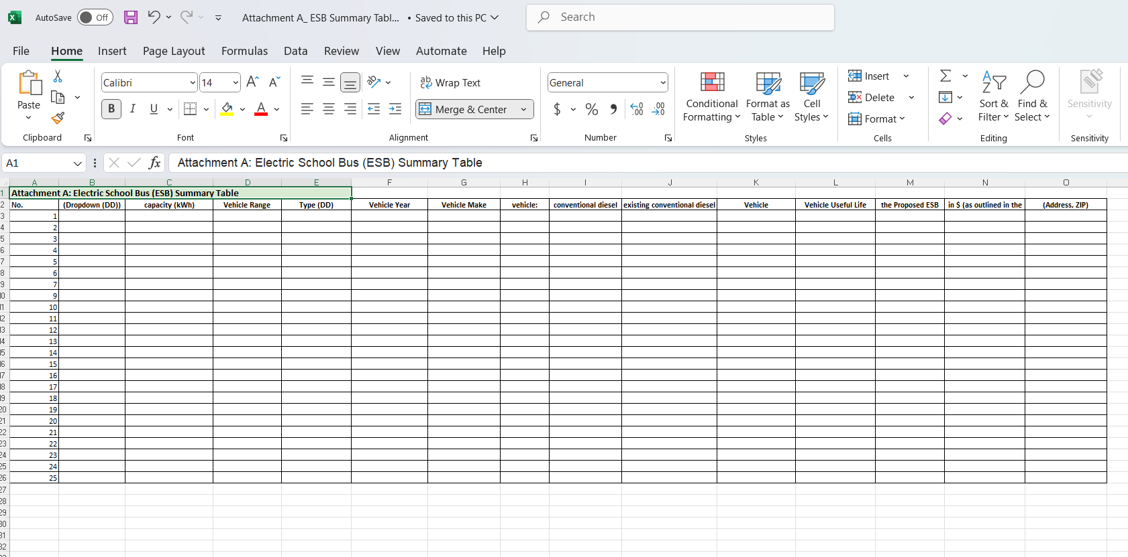
Grant Application Cont.
14 Items in the Summary Table

Slide 12
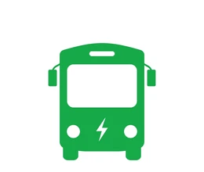
THANK YOU
Contact Information: For questions or support, please email us at: transportation.mea@maryland.gov or directly to the PM at natalie.buscemi@maryland.gov.
Stay updated on program news and deadlines at the MEA website:
MEA Transportation Programs

