Slide 1
Identifying And Communicating EECBG Success Stories
October, 2010
Chris Galm
EECBG Marketing & Communications Specialist

Slide 2
Objectives and Phases Driving Communication Needs
Program Phases
Program Initiation (FOA)
Spending quickly and effectively (Costing)
Results and impact
Money out (Obligation)
Celebrate Impact
Effective Management
Support Grantee Spending
Communications Objectives

Slide 3
EECBG Grants Are Flexible and Can Be Tailored To Fit Grantee Needs
Top 4 EECBG Activity Types
# Grantees per Activity
Examples of Additional Activities
Energy Audits
Building Codes and Inspections
Renewable Energy Technologies on Government Buildings
Development and Implementation of Transportation Programs
Energy Distribution Technologies

Slide 4
Proactive Communications Are Critical For The EECBG Program
Nature (And The News Media) Abhors A Vacuum!
If we do not regularly communicate progress and
success stories on our grants, the news media will make
up their own stories.
Which potential headline sounds better to you?
Energy Grant Project Ribbon-Cutting Tomorrow
or
What Happened To Our Energy Grant?

Slide 5

What Is A Success Story Anyway?
A good rule of thumb –
“Can you see Oprah Winfrey talking excitedly about your project on her show?”
We’ll hear MUCH more about
this unbelievable energy grant
right after the break…

Slide 6
What Is A Success Story Anyway?
1. JOBS CREATED
This is the biggest driving interest in our success stories
given the current economic situation in many of the grantee
communities.
The potential for the rapid development of positive job
numbers was the PRIMARY motivating factor in the
development of the Recovery Act.
Project Officers must to be able keep track of how many
jobs (full or part time) will be created with each grant.

Slide 7
What Is A Success Story Anyway?
2. PROJECTED BENEFITS/ AUDIT RESULTS
Preliminary audits connected to many grants can shed light
on potential energy savings and future project details.
Will a retrofitted municipal building’s energy savings be 5
percent or 50 percent?
Will the wastewater plant renovation project save taxpayers $5,000.00 a year or $55,000.00?
These issues alone could warrant a great deal of public
communications outreach work.

Slide 8
What Is A Success Story Anyway?
3. COMMUNITY INITIATIVE
Are communities aggressively implementing their projects?
Are they working collaboratively with other local/regional
government or non-profits?
Other questions that can identify success stories:
Is this the first DOE or federal grant ever received by the grantee?
Is the entire community behind it?
How extensive is the list of stakeholders/partner businesses/agencies?

Slide 9
What Is A Success Story Anyway?
4. INNOVATION/SUSTAINABILITY
Is the grantee using the EECBG funds as a catalyst to
completely change the way the community utilizes energy
resources?
Is the grantee reducing the amount of energy being used, or
will they reduce energy use WHILE increasing the use of
renewable sources of energy?
Is the project being funded by the EECBG going to pay off
for years down the road, or possibly decades?

Slide 10
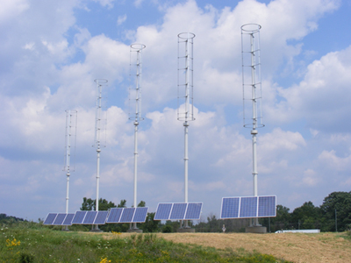
Examples of Early Success Stories
Genoa Township, MI
Genoa Township, a charter township in Livingston County with about 16,000 residents, used $94,000 in EECBG funds to purchase five, 1.9 kW Windspire units.
The entire 9.5kW system will supply up to 20 percent of the township hall's electrical needs.
The highly visible Michigan-manufactured units were installed along Interstate 96, which carries about 100,000 cars every day.
The turbine/solar panel hybrid generates about six decibels of noise, which is comparable to hearing leaves blow in the wind.

Slide 11
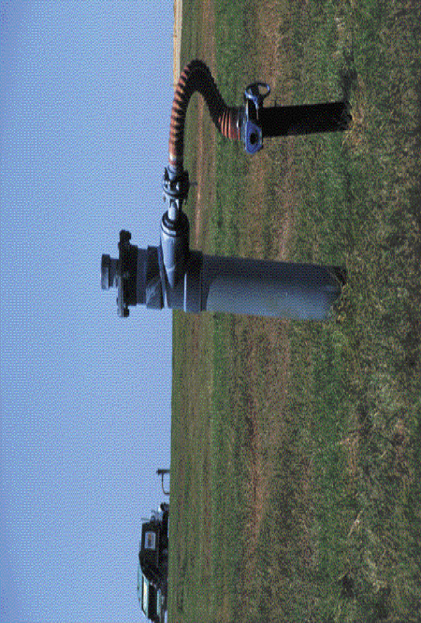
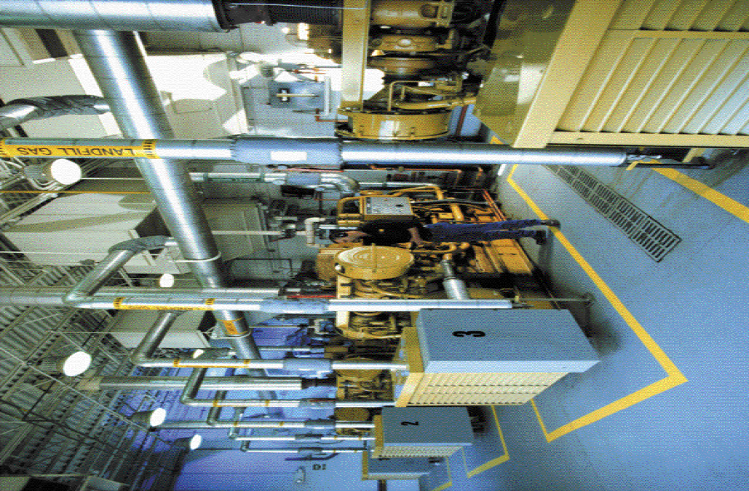
Will County, Illinois
450 acres of former Joliet Arsenal ammunition plant turned into landfill by county.
Partnership with Waste Management to develop landfill gas electricity generation plant using $1 million of EECBG funding.
The plant will initially generate 4.8 megawatts of green electrical power and grow to meet the electricity needs of 3,800 to approximately 8,000 Will County homes for decades to come.
A portion of the revenue generated by the project to be used to continue funding the county’s sustainability office.

Slide 12
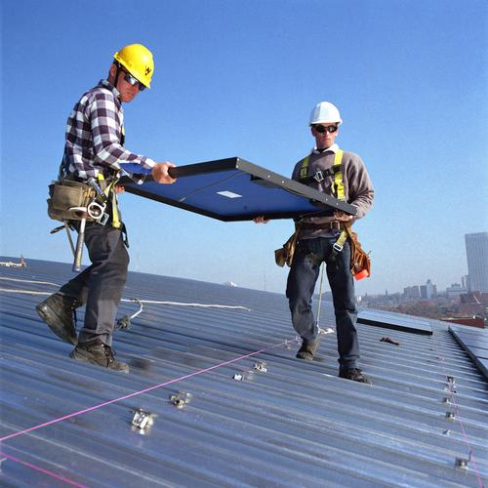
Allen, Texas
Allen, Texas used EECBG funding to install a 90-panel solar energy system on a municipal garage, to produce 27,500 kilowatt hours of clean electricity annually.
The city estimates that the renewable energy system will avoid carbon dioxide emissions of 19.7 metric tons per year - the equivalent of planting 4.2 acres of trees.
The system started generating solar energy on Feb. 15, 2010.
Allen City Television installed a camera at the worksite to create a series of time-lapse images, which were combined to create a video of the installation process.
The video has been posted on YouTube and is profiled on the Energy Empowers website.

Slide 13
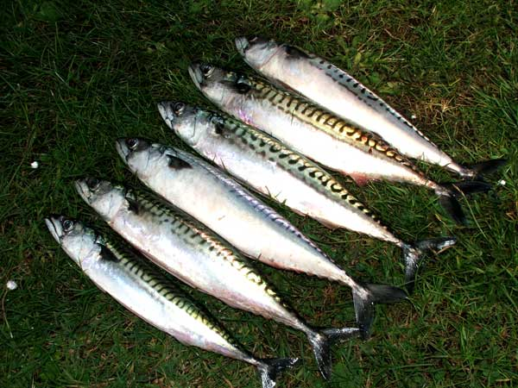
How Success Stories Are Used
Media updates/ press releases /
fact sheets
Events for senior DOE/ White
House staff
Interview material / press pitches
Energy Empowers profiles
“OK, We caught ‘em. Now what?”
Best practices materials
Congressional hearings/responses
Developing state/regional EECBG impact snapshots

Slide 14
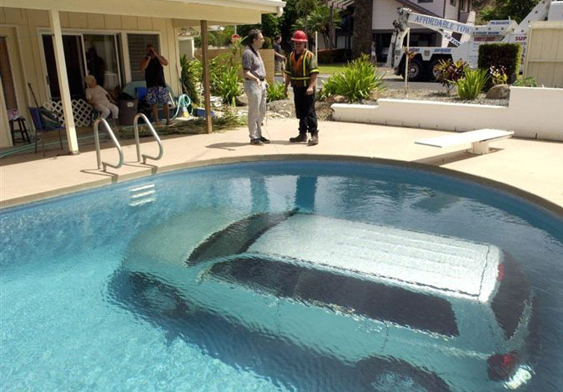
Potential Obstacles
1. Grantees not focused on public outreach
2. Limited grantee resources
3. Incomplete project data/vague
summaries
4. Opposition from state/local elected
officials

Slide 15
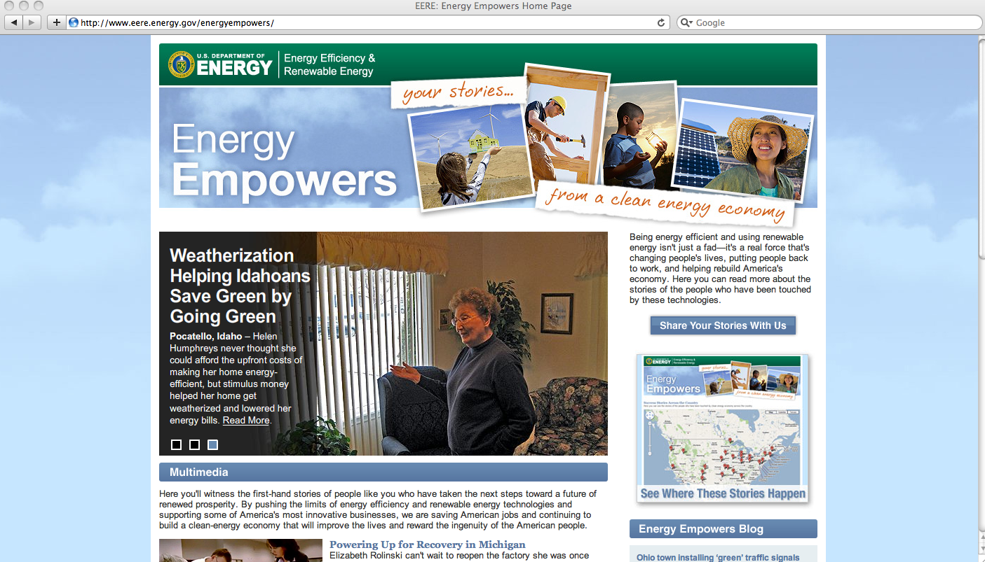
Energy Empowers Website –
Documenting Success Stories
15

Slide 16
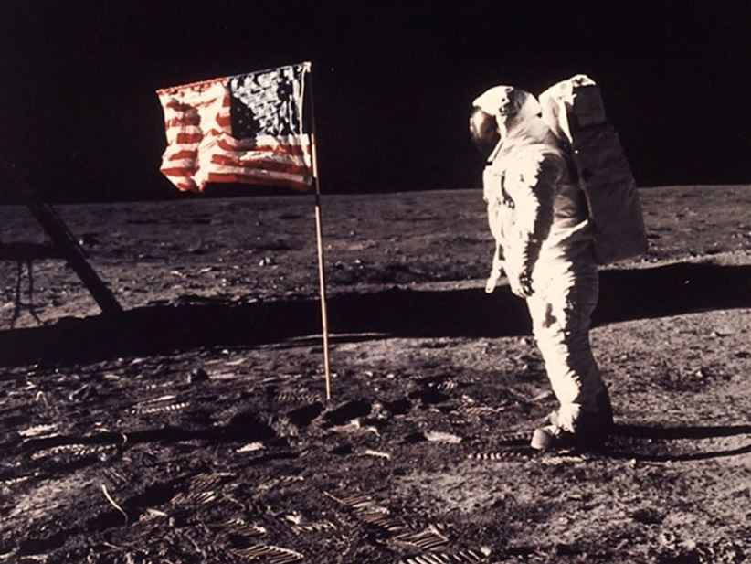
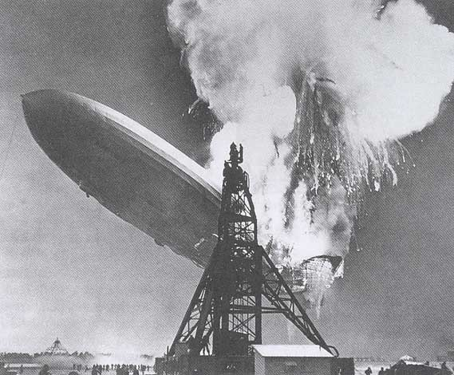
Public Perceptions Matter!
What we want
What we DON’T want
World-class innovation and results “$3.2 billion for this?”

Slide 17
Contact Info
Chris Galm
Marketing & Communications Specialist
202-287-1725 (office)
202-215-6804 (cell)
Christopher.Galm@ee.doe.gov

